Slide 1
Video Post Process on Merrifield
Wang Kun
2012.02

Slide 2
Agenda
Video subsystem overview
VPP Filters and FRC(Frame Rate Conversion)
VPP control flow
A simple demo program

Slide 3
VPP and FRC support on MRFLD
With the addition of the VSS subsystem to the Tangier SOC, the Merrifield platform is now capable of performing sophisticated VPP(Video Post Processing) operations on decoded video streams before they are rendered to the display.

Slide 4
Video subsystem overview

Slide 5
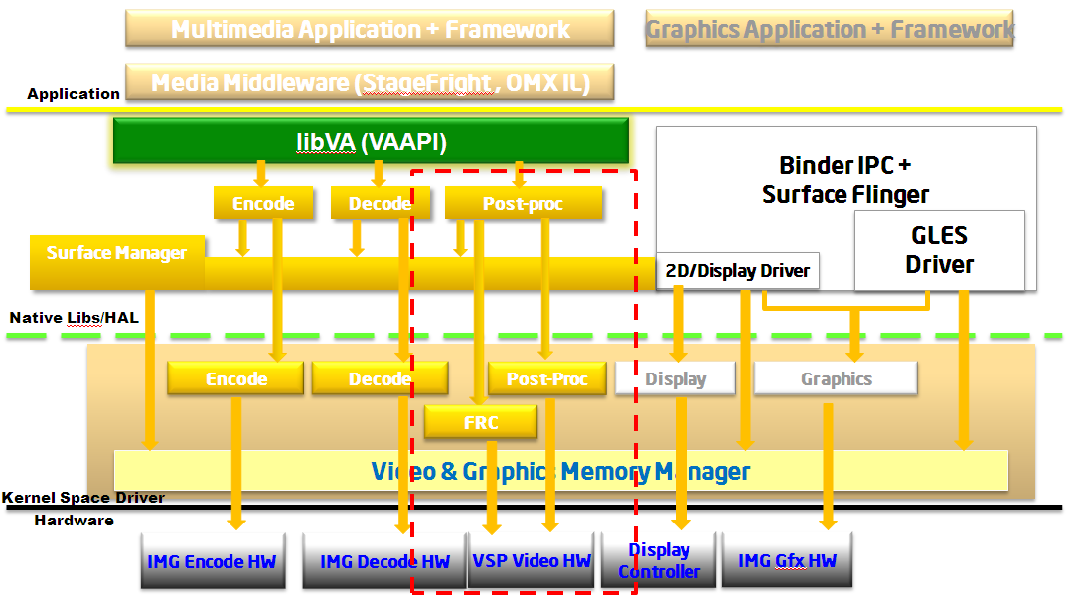
VPP architecture

Slide 6
VPP Filters
The VSP will support the following filters:
Deblocking
NoiseReduction
Sharpen
ColorEnhancement
FRC(Frame Rate Conversion):2x, 2.5x, 4x

Slide 7
Video Post Process control flow
vaInitialize
Query VPP entrypoint and Create Configuration
vaCreateSurface
vaCreateContext
Query pipeline and filter caps
vaBeginPicture
vaRenderPicture(PipelineParamBuffer)
vaQueryVideoProcPipelineCap
vaRenderPicture(InputParamBuffer)
vaRenderPicture(Filter1ParamBuffer)
vaRenderPicture(FilterNParamBuffer)
vaEndPicture

Slide 8
A simple Demo(1)
Following is a sample program to demonstrate how the API is used to perform FRC from one frame rate to another:
1. /* find out if post-processing entrypoint is available */
vaQueryConfigEntrypoints();
2. /* create config for post-processing */
vaCreateConfig();
3. /* create surfaces to hold input and output frames */
vaCreateSurfaces();
4. /* create context for post-processing */
vaCreateContext();
5. /* query pipeline level capabilities */
vaQueryVideoProcPipelineCap();
6. /* create the pipeline and input parameter buffers */
vaCreateBuffer(…&pipeline_buf); vaCreateBuffer(…&input_buf);

Slide 9
A simple Demo(2)
7. /* may need four FRC parameter buffers to accomodate 15->60 conversion */
vaCreateBuffer(…&frc_buf[0~3]);
8. While( input_frames_to_be_processed ) {
vaBeginPicture();
/* setup pipeline parameter(VAProcPipelineParameterBuffer) */
vaRenderPicture(…, &pipeline_buf);
/* query reference frame requirements for this pipeline */
vaQueryVideoProcReferenceFrameCap();
/* setup input parameter (VAProcInputParameterBuffer) */
vaRenderPicture(…, &input_buf);
/* set up multiple FRC parameter (VAProcFilterFRCParameterBuffer) */
vaRenderPicture(…, &frc_buff[0~3]);
vaEndPicture();
}

